Slide 1





Team – 7 General Insurance System

Slide 2
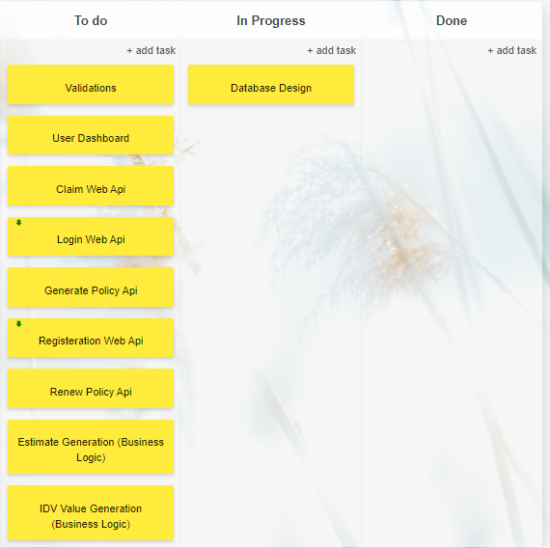
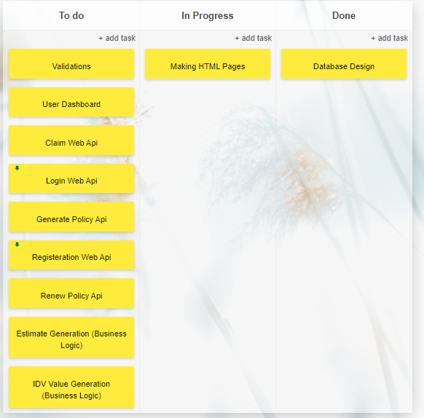
Day 1 - Prateek , Rupal , Sahil - Database Finalisation
Making of the Project
Day 2 - Prateek , Rupal, Sahil
- Html pages

Slide 3
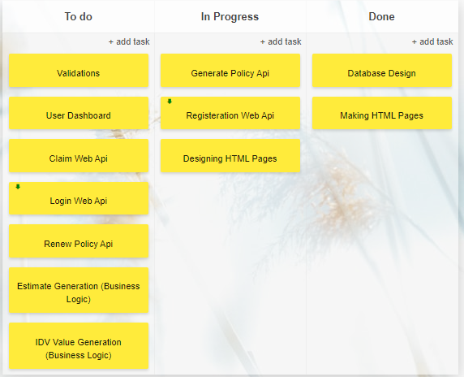
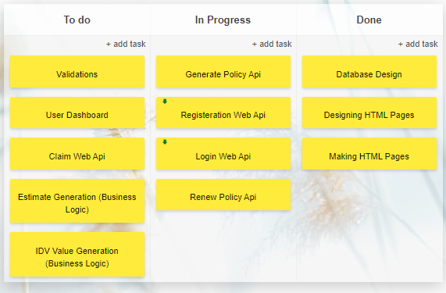
Day 3 - Prateek - policy purchase Api
Rupal -Registration
Sahil - Html Designing
Day 4 - Prateek - policy
purchase Api and login
Rupal - Registeration
Sahil - Renew

Slide 4
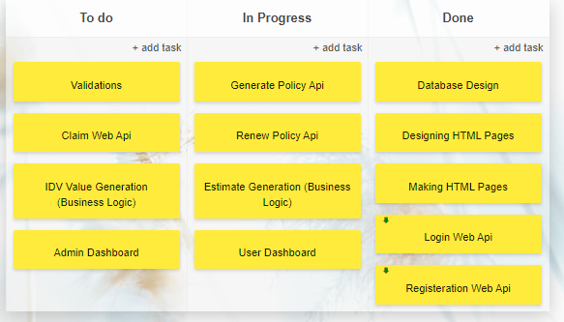
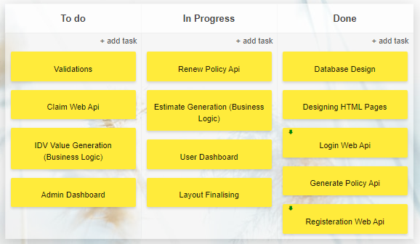
Day 5 - Prateek - Policy purchase, with
business logic implementation
Rupal - user dashboard
Sahil - Renew
Day 6 - Prateek - Estimate calculation
Rupal - User-dashboard , Renew
Sahil - Renew, layout Finalising

Slide 5
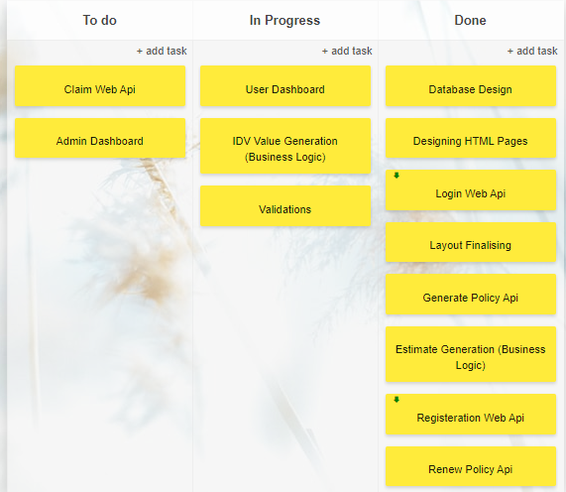
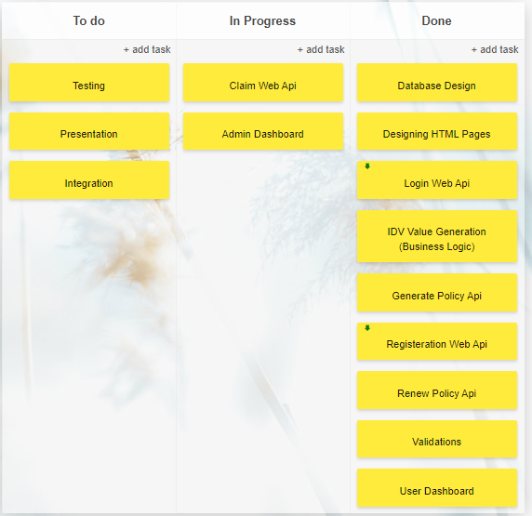
Day 7 - Prateek – Estimate Calculation
Rupal - Admin Dashboard
Sahil - Validations
Day 8 Prateek - Claim
Rupal - Admin Dashboard
Sahil - Claim

Slide 6
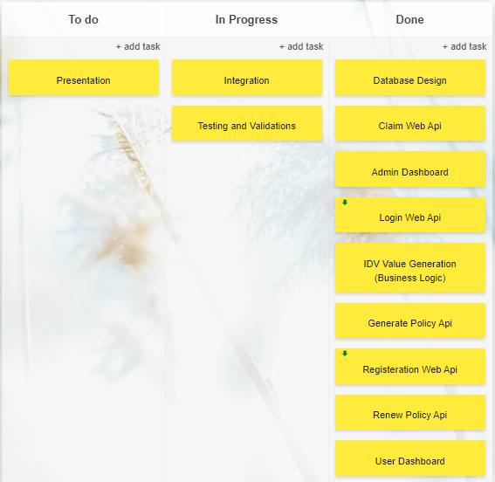
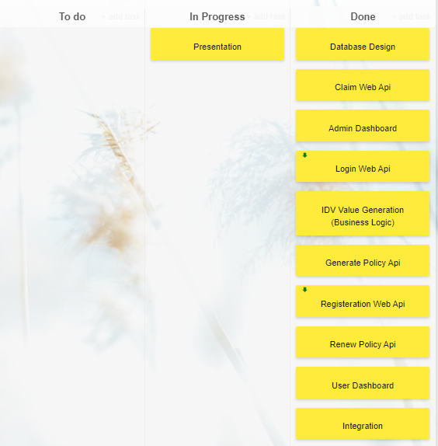
Day 9 - Prateek - Integration , routing
Rupal - Validations , Designing
Sahil - Checking Validations
Day 10 - Ppt and all integrations

Slide 7
ISSUES
Inter component communication
Using service for authorisation
Managing time
OTP Generation

Slide 8
Learnt New
Inter component communication
Working around web Api
Implementing authentication in angular using web Api
Maintaining session in angular using web Api data
Continuous integration, got to understand the real benefits of using github.
Got to understand the complete working of a web Api.

Slide 9
Thank You

